Slide 1

Web Programming SECV2223-15
Group 1
Ruhul Quddus Tamim
Md Yusuf Bin Forkan
Shafi Ahmed
Syafiq Ibnu Ramadhan

Slide 2
Users
System Admin
Client
Mechanic

Slide 3
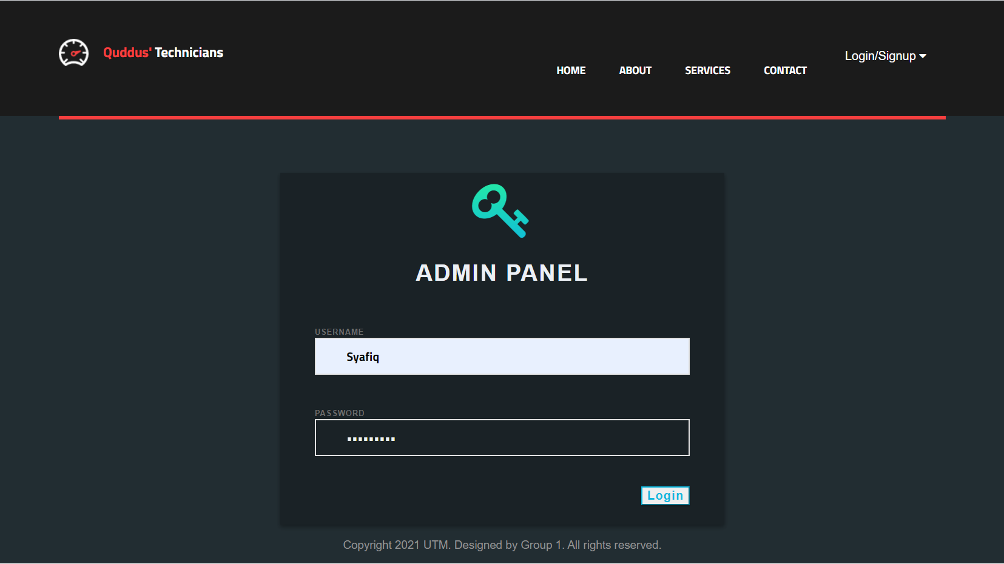
System Admin
System Admin types in username and password

Slide 4
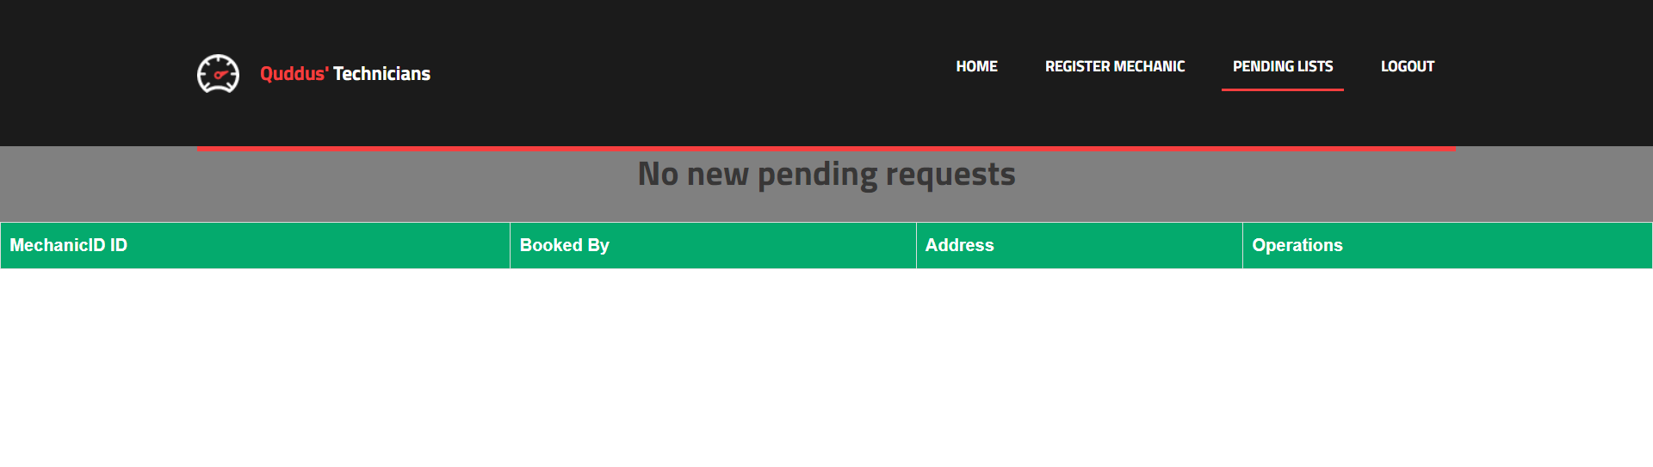
System Admin
When there are no bookings to accept

Slide 5
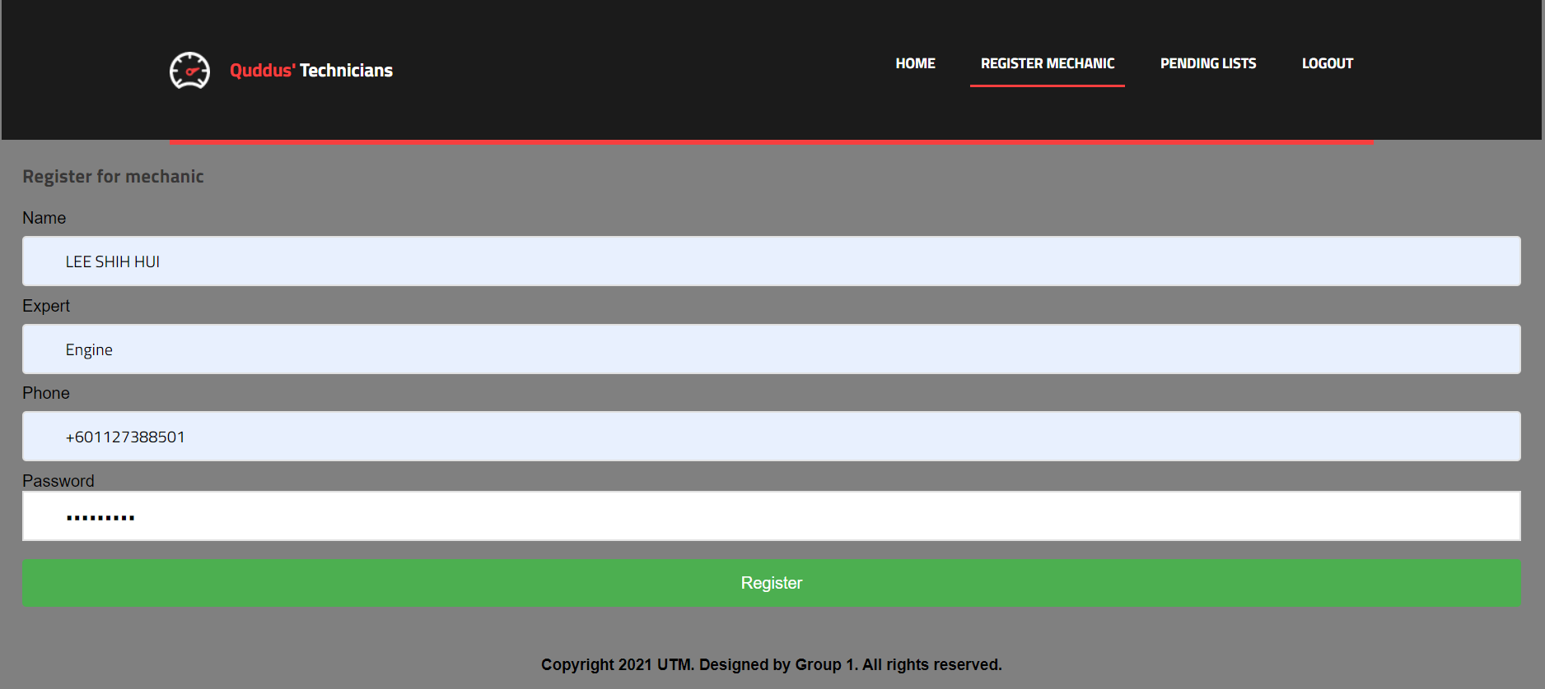
System Admin
Registers mechanics profile

Slide 6
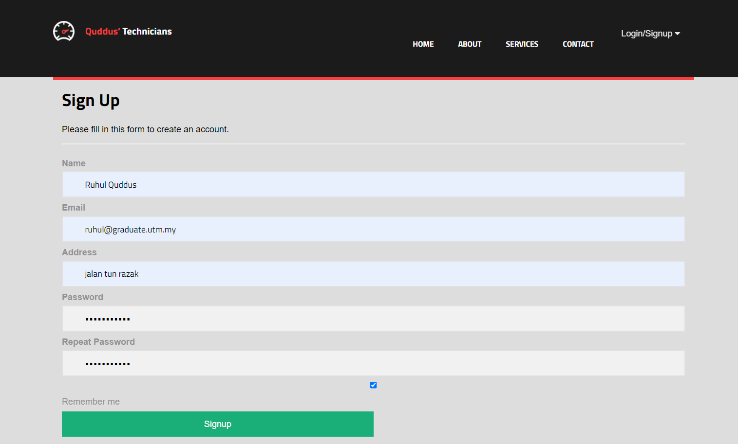
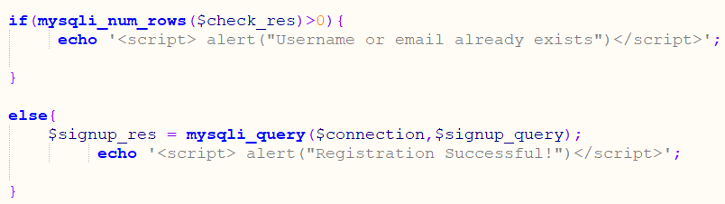
Client Signup
Users registers their own username and password.
If the username or email is already taken, the system ask for another username and email.

Slide 7
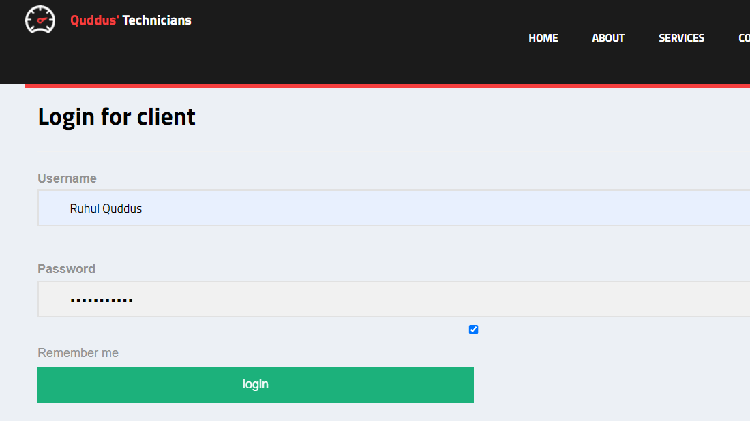
- after the user is registered, the user can login

Slide 8
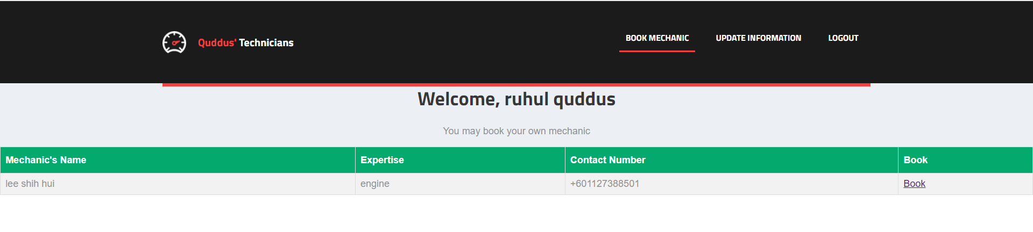
Client
Can book the mechanics from the list where System Admin registers for Mechanics

Slide 9
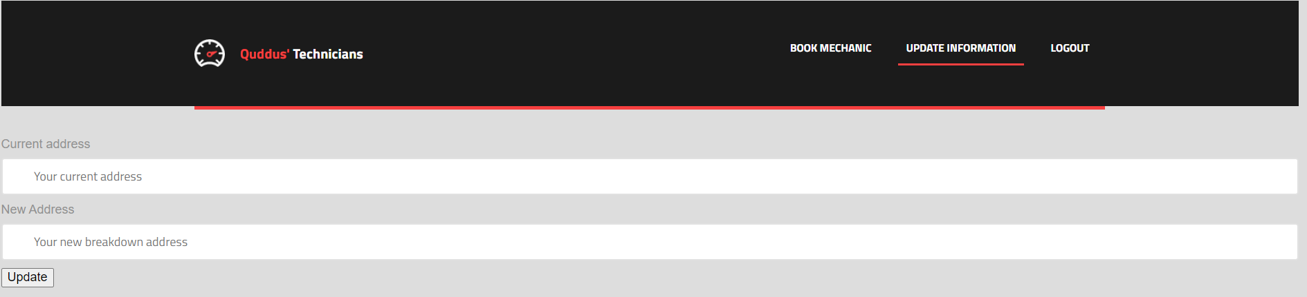
Client
Client can update their current location of vehicle breakdown

Slide 10
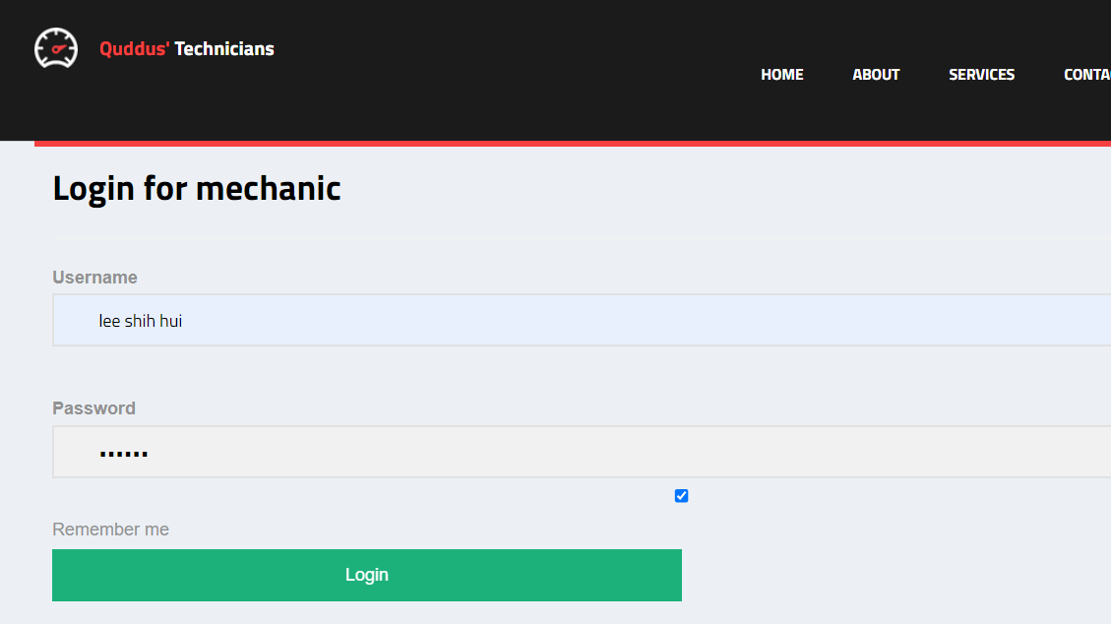
- after the system admin registers for mechanic, then the mechanic uses the system

Slide 11
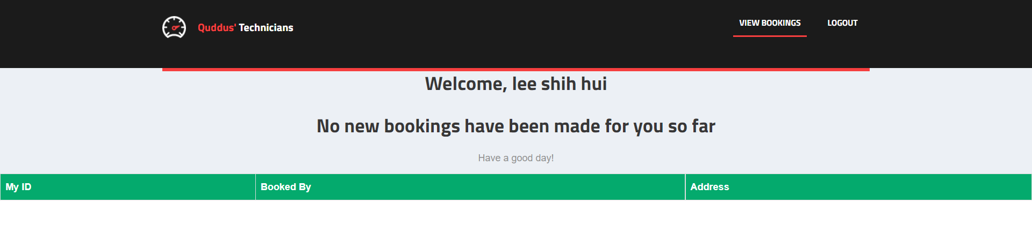
Mechanic
When there is no bookings from clients, the system displays no bookings made

Slide 12

Thank You

